Slide 1
Event driven system using Azure CosmosDB
Address book management service
František (Fero) Kaduk
8th of June 2019
Principal SW Developer

Slide 2
Use-case study
https://azure.microsoft.com/en-us/blog/how-skype-modernized-its-backend-infrastructure-using-azure-cosmos-db-part-1/

Slide 3

František Kaduk Microsoft, Prague, Czech republic
Blog
http://fknet.wordpress.com/ https://blogs.msdn.microsoft.com/fkaduk/
@kadukf
frantisek-kaduk

Slide 4
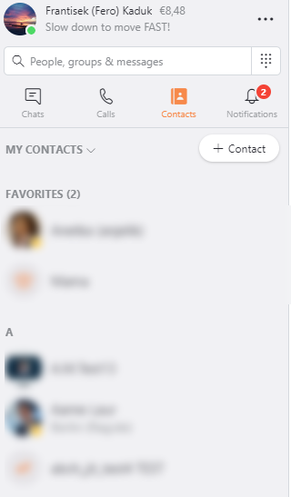
Welcome to ...
Address book management service
Domain
Address book
Contacts & Relations
Invites, Names, Phones
Groups

Slide 5
Few facts
15K+
99.9%
2.6B+
Reads per second (peak)
5K+
SLA
Address books
Writes per second (peak)
2+
ASP.NET Core 2.2
.NET 4.6.2 Azure PaasV1 Azure Cosmos DB
150TB+
Years in production
7 DCs
Storage
Globally available

Slide 6
Request driven architecture
Client
Service
DB
System #1
System #2
Pros:
Simple to implement
Domain logic
Cons:
SLA:
Latencies
QoS
Consistency across systems
Complex business logic
State dependent

Slide 7
Business requirements
SLA(QoS)
99.90% = 99.95% x 99.95% = depends on other systems’ QoS
SLA(Latencies)
<100ms 99th percentile for relation checks
<1s for 99th contact list size
System consistency as whole
Extra: audit log

Slide 8
A proposal addressing SLA
Splitting responsibilities
Domain logic
Scoped to 1 domain root aggregate only!
Frontend/API part
Integration logic
Communication with other external systems or with other domain root aggregates
Background part

Slide 9
A proposal addressing SLA
Splitting responsibilities
Client
Service
DB
System #1
System #2
Domain handling part
Integration part
Challenges
Coordination between domain and integration parts
Cross system distributed transactions

Slide 10
A proposal addressing audit log
Event sourcing
Recording changes to the domain as events
Events = Source of the truth
Replaying events = current state
t0
t1
time
State(t0) = A+B+C
State(t1) = A+B+C+D
State(t1) = t0+D
Snaphosts
A state in a time
Once a week ?

Slide 11
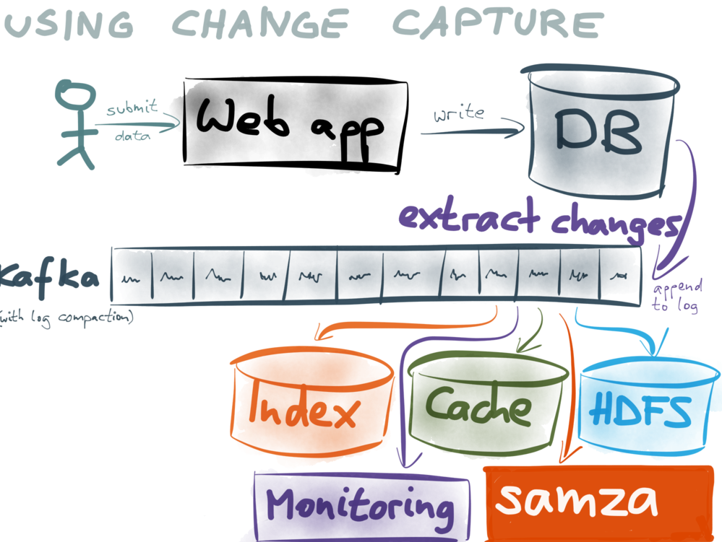
A proposal addressing audit log
Change capture pattern
Captures current state and change
Martin Klepmann
Event
Domain event
Metadata
Current snaphost

Slide 12
High-level overview

Slide 13

Azure CosmosDB
Schema-free document database
Table = Collection
SQL syntax, indexes
Geo-replicated
Elastic scale out of storage and throughput
SLA
<10ms point read/write at 99th percentile
99.999% for reads/writes
Multi-partitioned collections

Slide 14
Azure CosmosDB
Transaction support
Scoped to single partition in a collection
Change feed support
Optimistic concurrency
Using etag

Slide 15
Write operations on CosmosDB
Multipartition collection
By address book
Documents per item
Change set
Domain aggregate
Contact
Group
Events

Slide 16
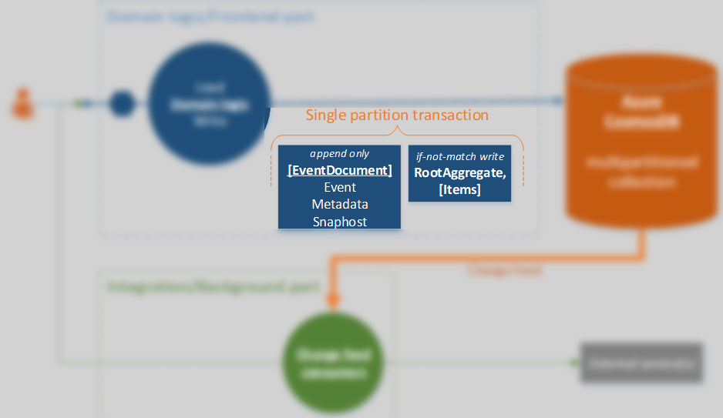
CosmosDB transactions

Slide 17
Demo
Azure CosmosDB transactions

Slide 18
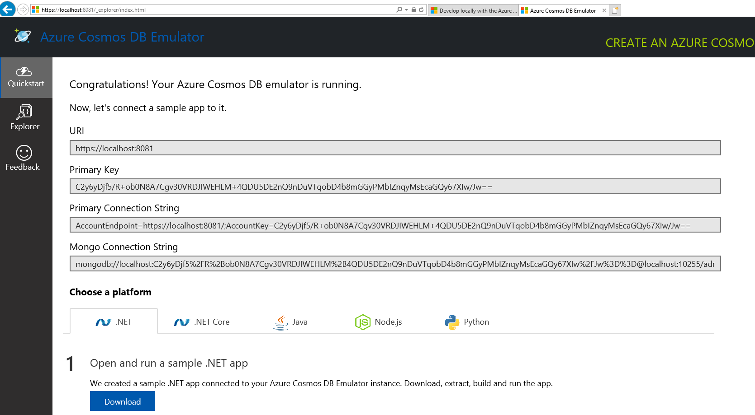
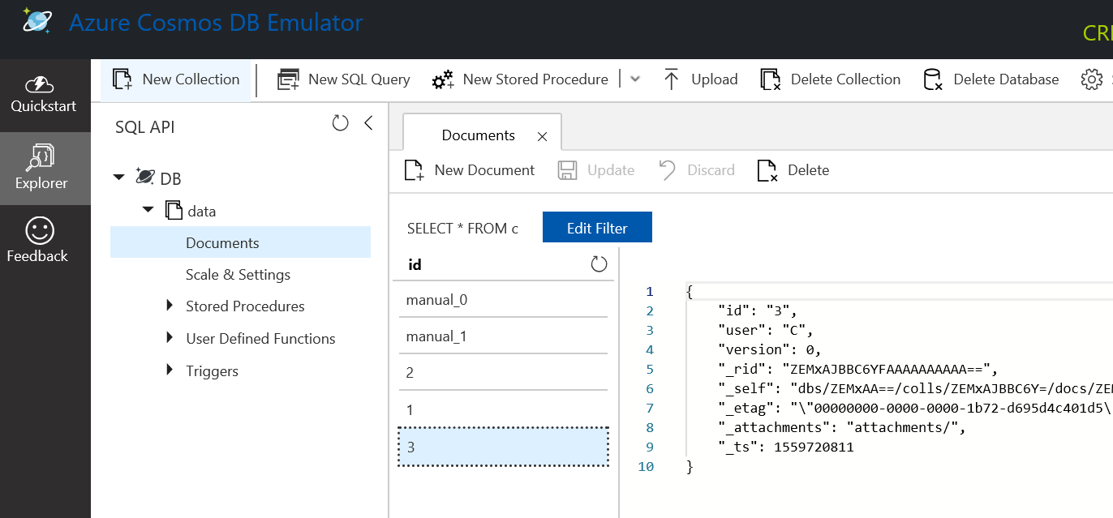
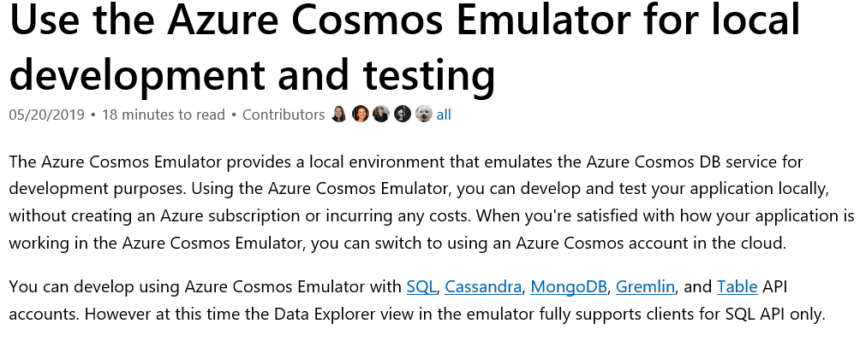
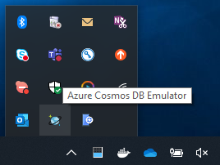
Azure CosmosDB

Slide 19
Azure CosmosDB transactions
Stored procedures
Written in Javascript!

Slide 20
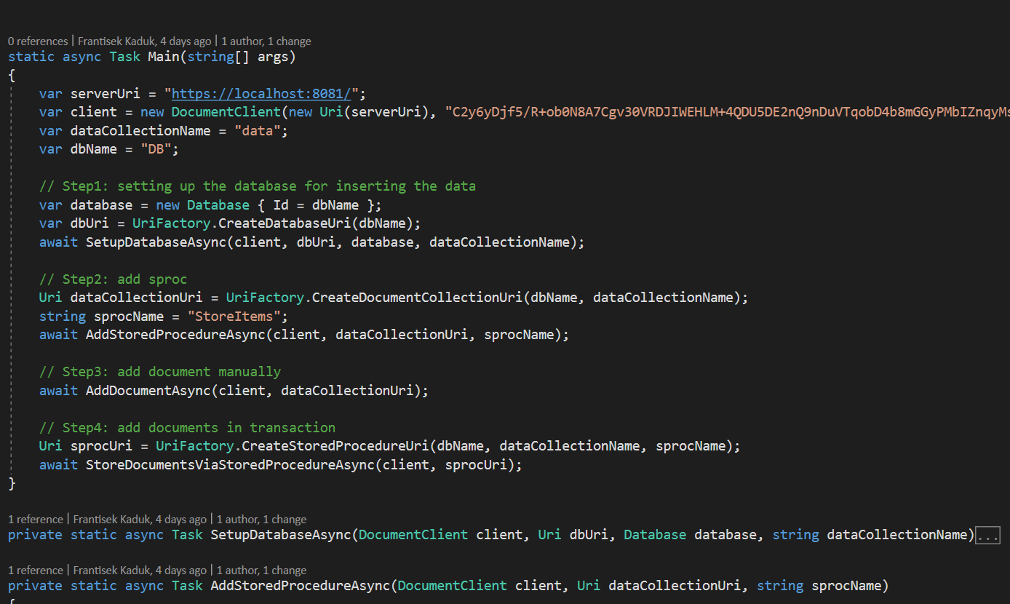

Slide 21
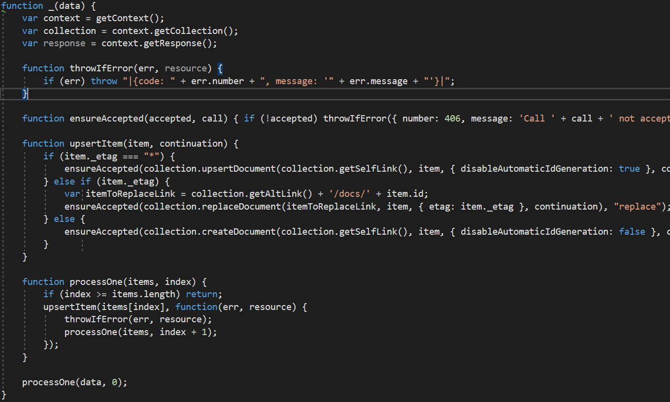
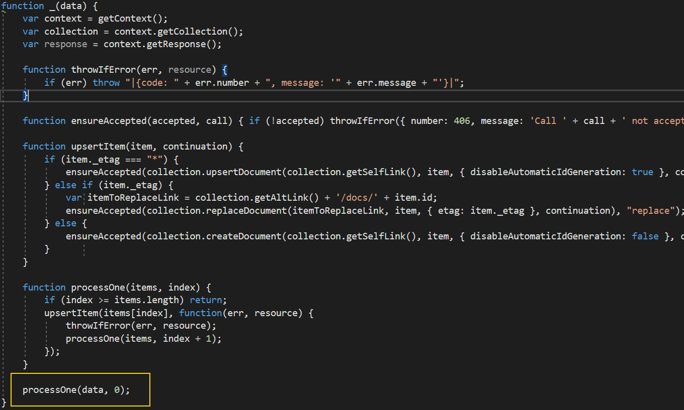
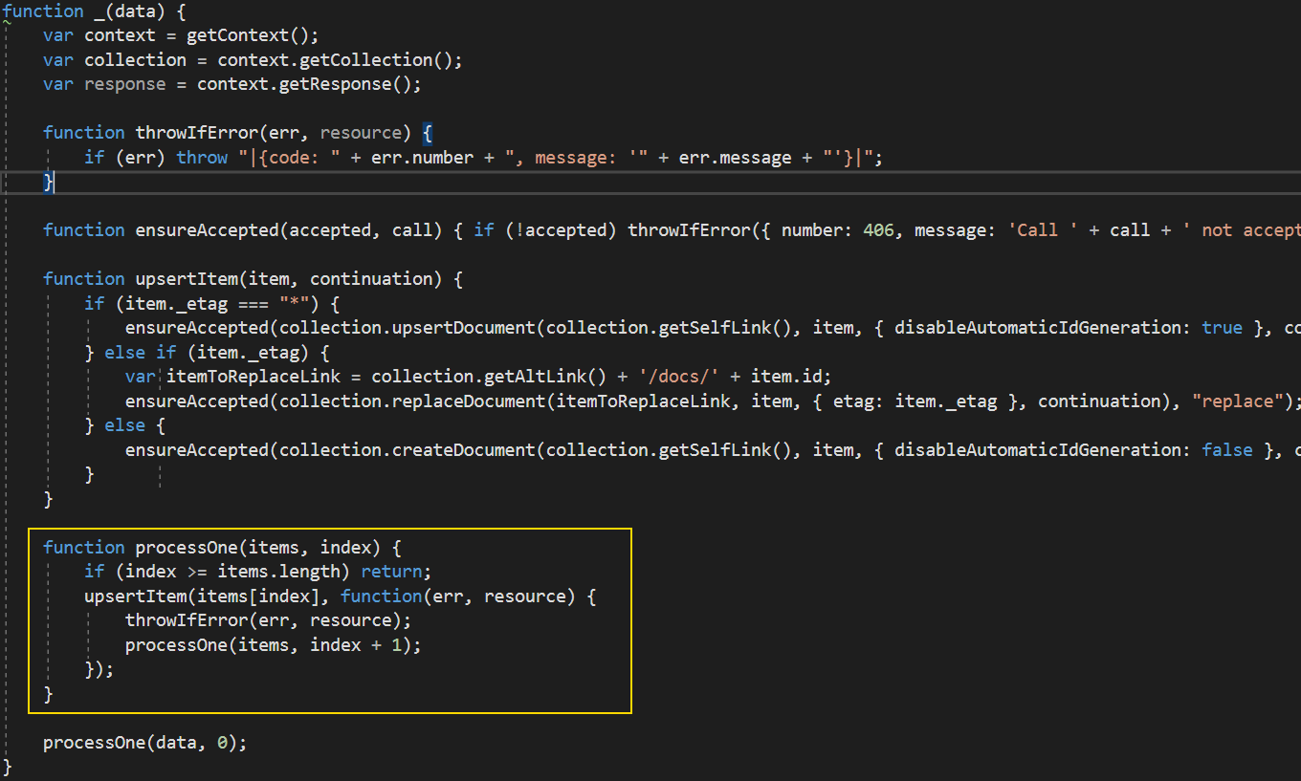

Slide 22
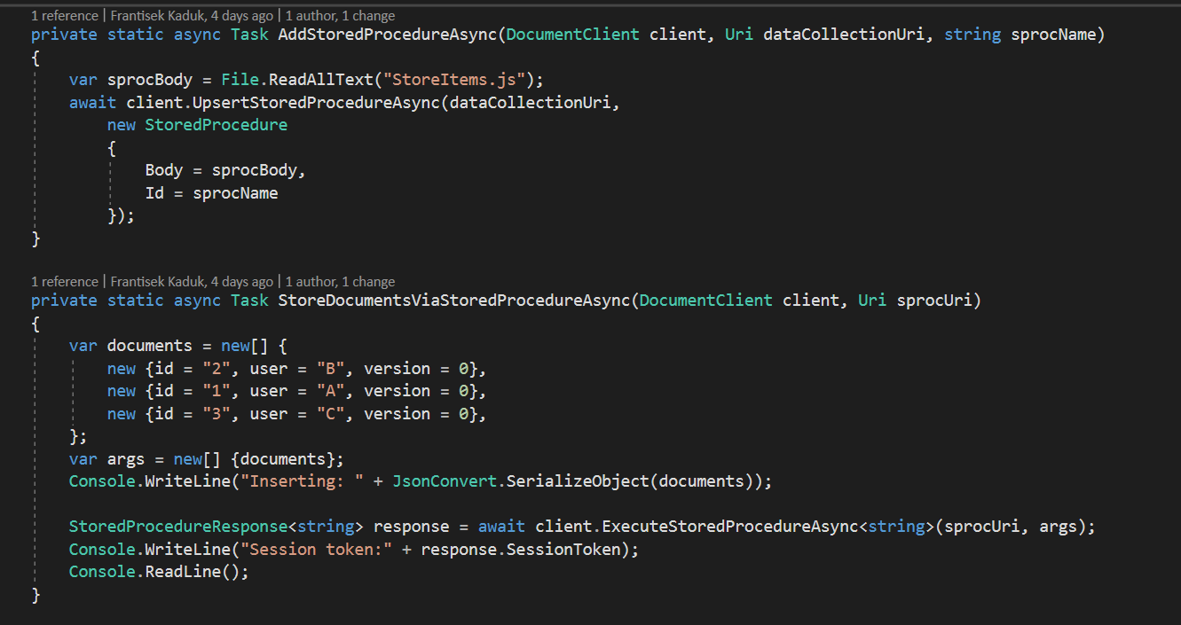

Slide 23
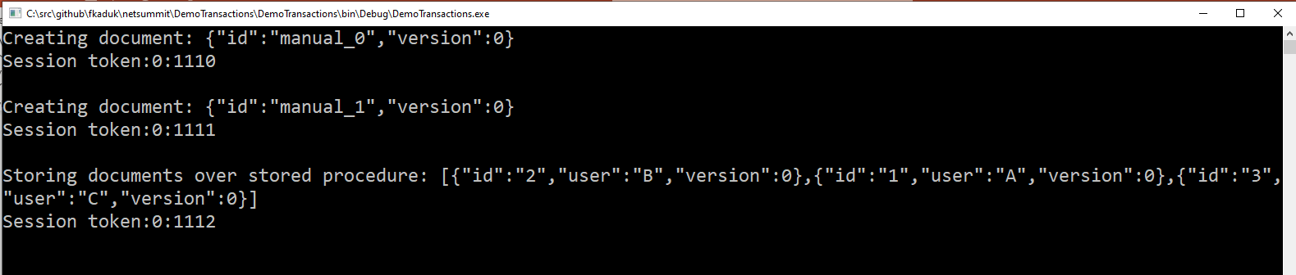
Session token
<partition ID:transaction ID>

Slide 24

CosmosDB change feed

Slide 25
CosmosDB change feed
Introduction
Sorted by the modified order
Latest changes
Update A(1)
Insert B(0)
Insert A(0)

Slide 26
Demo
Azure CosmosDB change feed

Slide 27
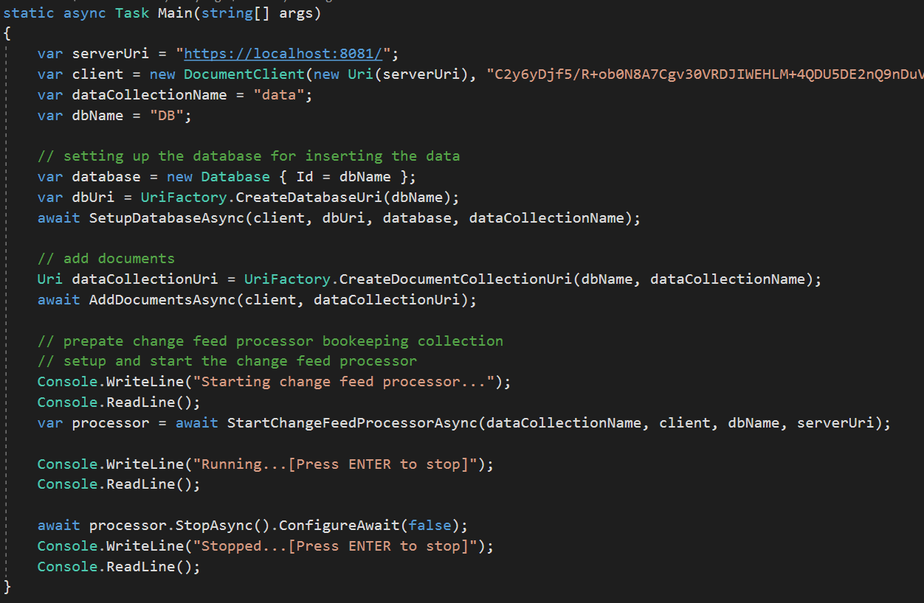

Slide 28
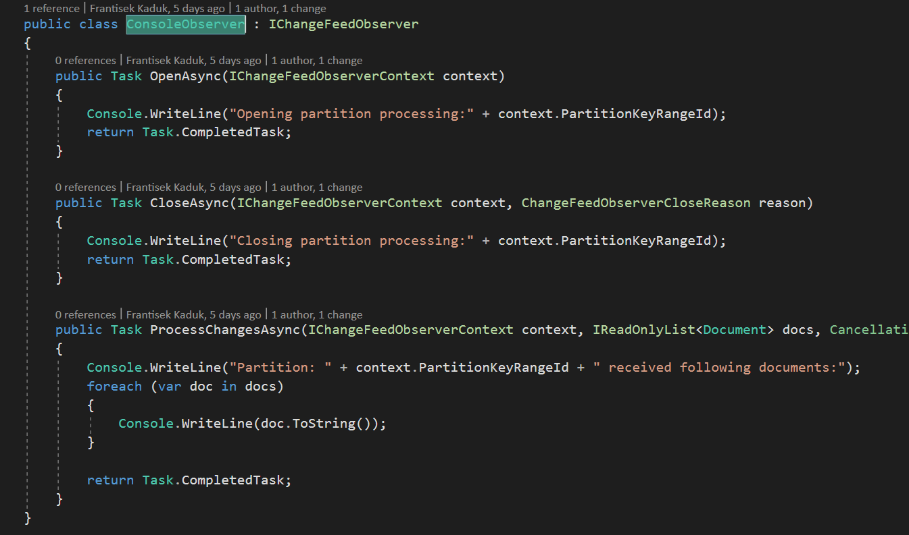
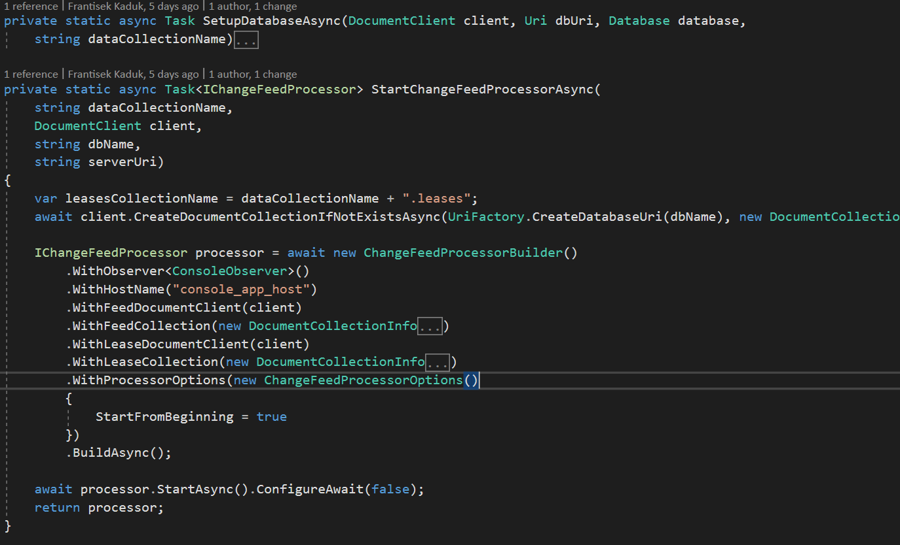
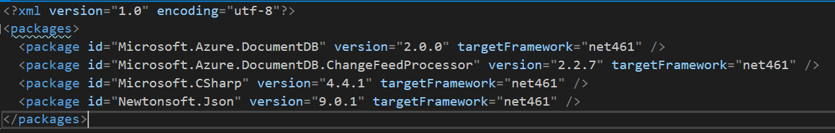

Slide 29
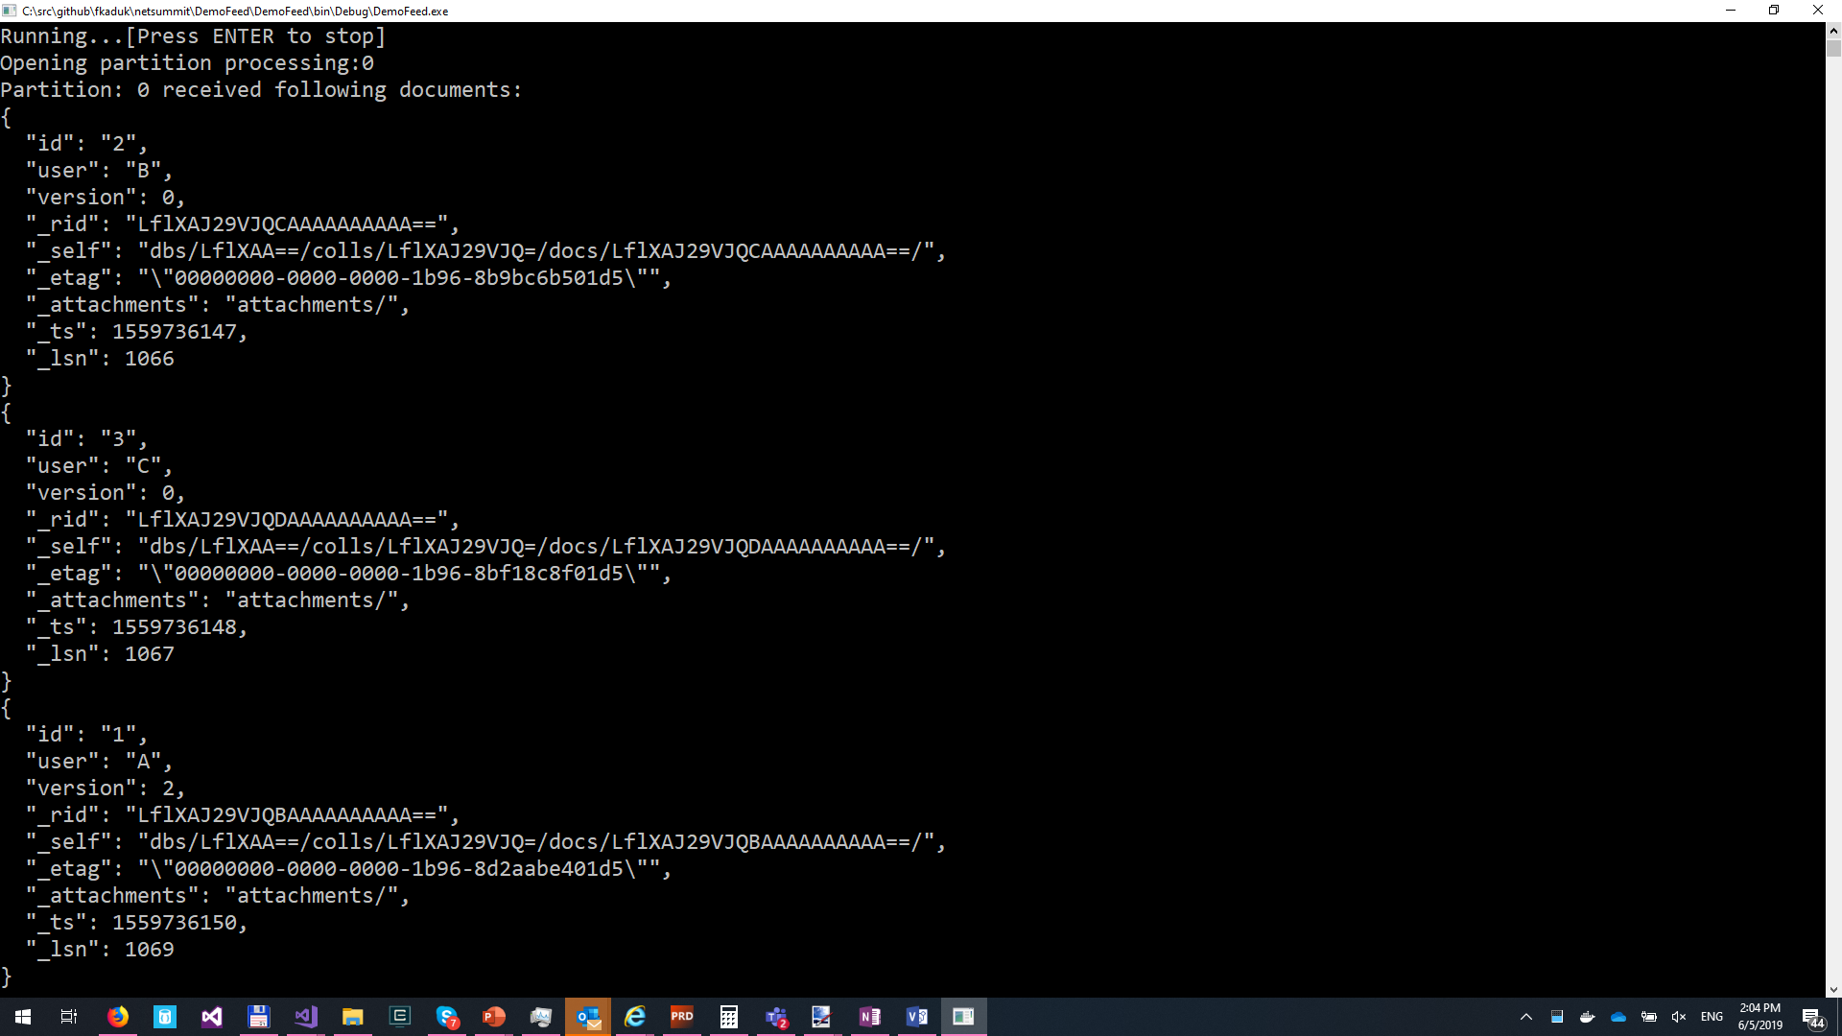
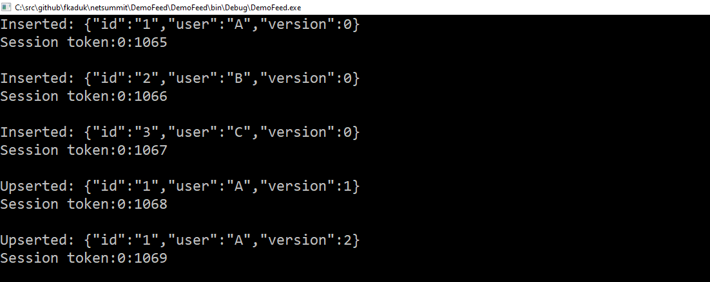

Slide 30
CosmosDB change feed
Transactions and change feed
Event A(1)
Update A(1)
Event A(0)
Insert A(0)
_lsn: 2
_lsn: 1
Events in append-only mode

Slide 31
Demo
Azure CosmosDB transactions and change feed

Slide 32
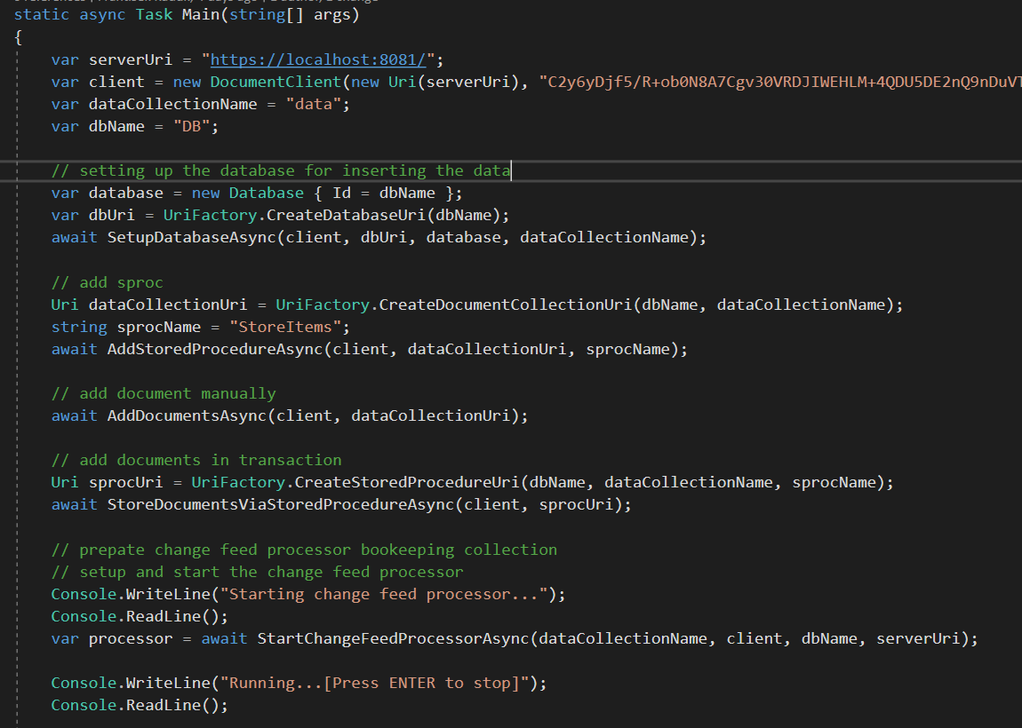
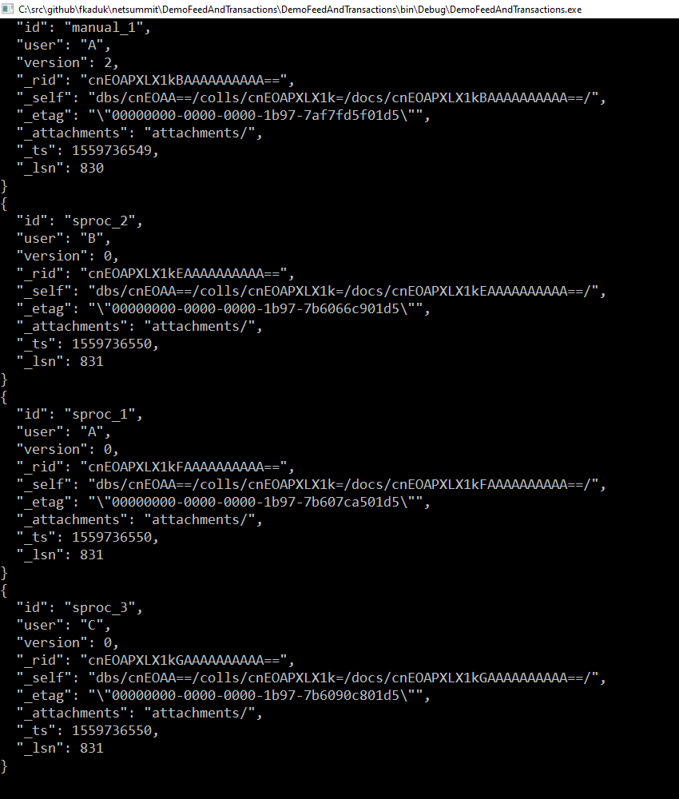
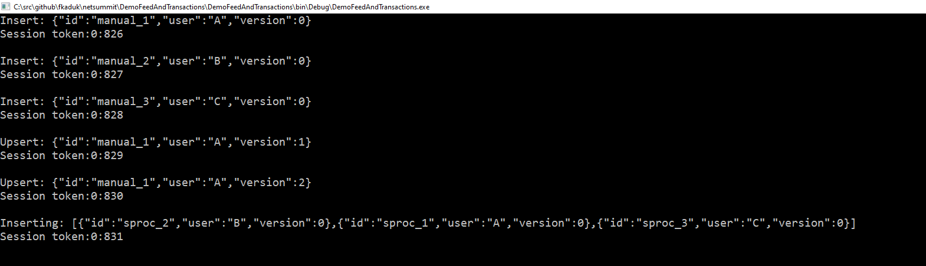

Slide 33
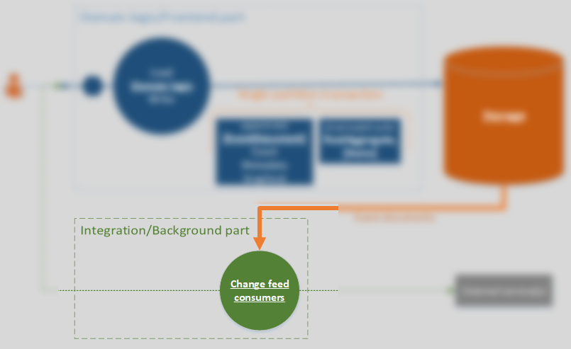
Background processing

Slide 34
Background processing
Heart of the system
Event documents
Past, immutable state
Must be complete enough
Read-only access to storage

Slide 35
Background processing overview
Asynchronous processing library
Events
Change feed
Event Handler
External System
Retry feed
Retry Queue
Dead Letter

Slide 36
Demo
Reliable background processing

Slide 37
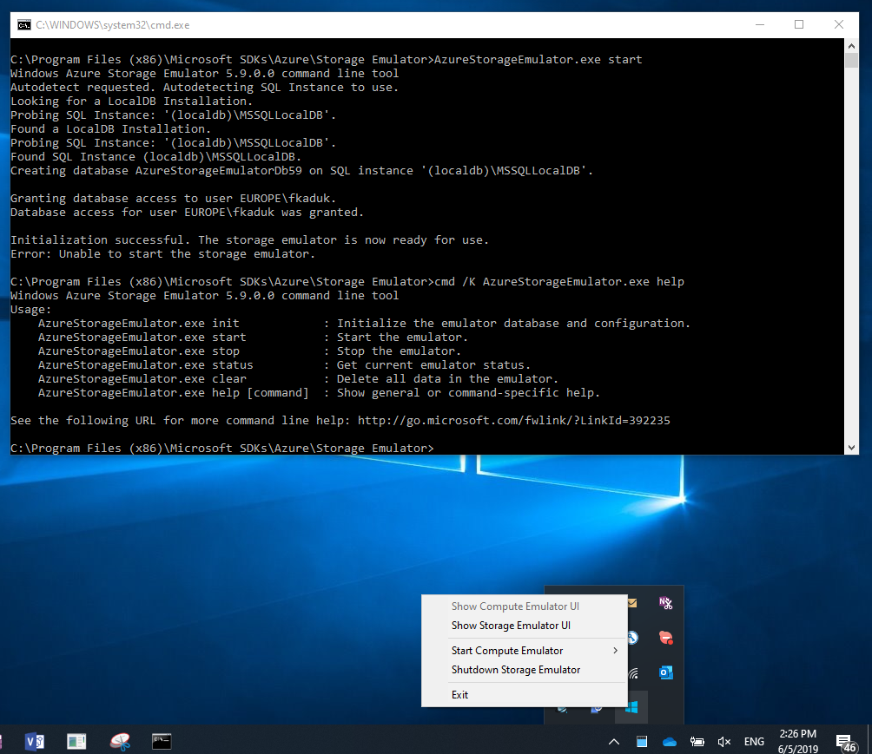
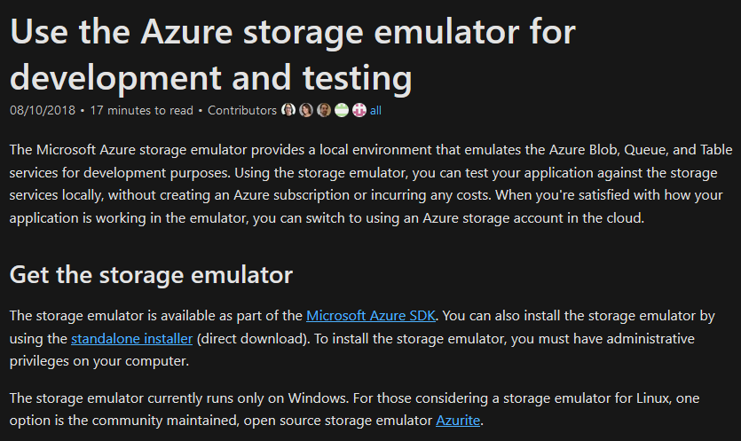

Slide 38
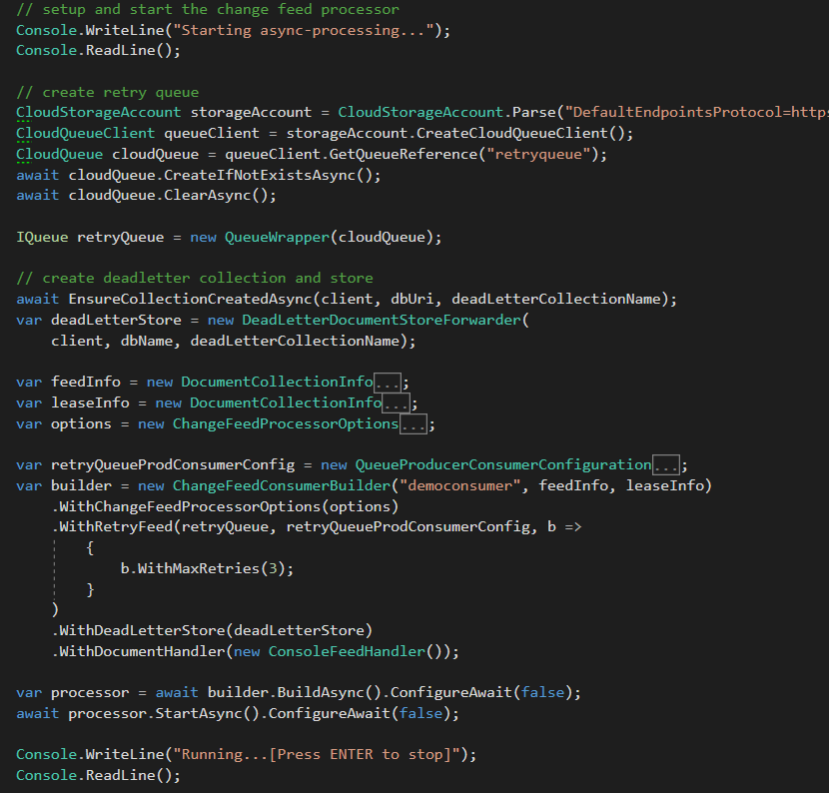

Slide 39
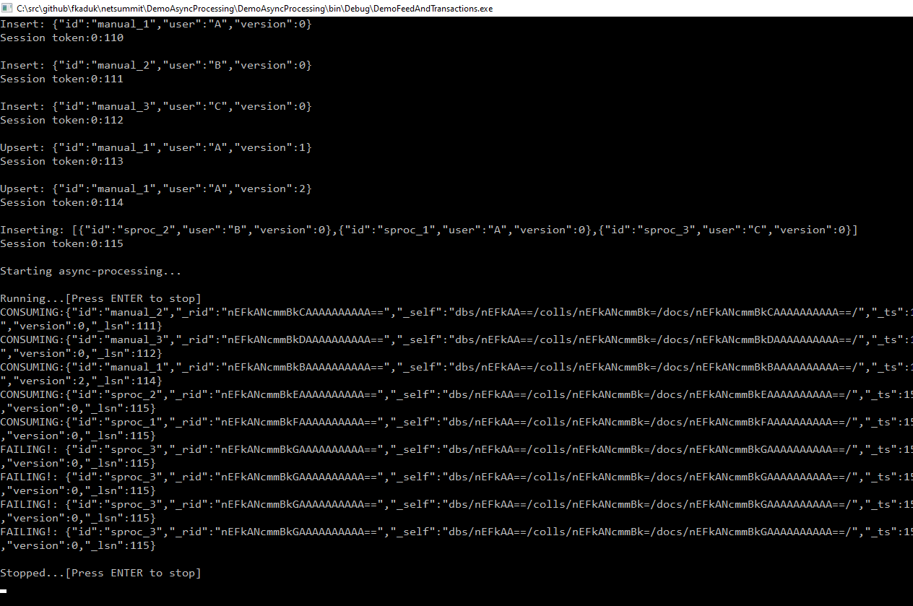
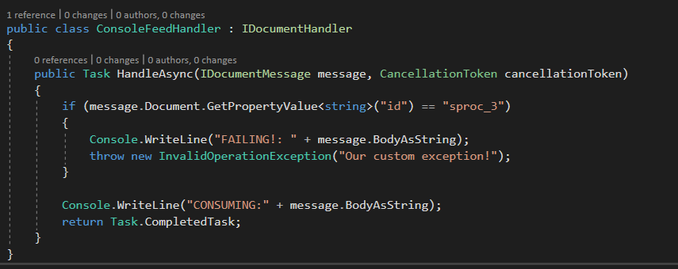

Slide 40
Background processing overview
Asynchronous processing library
Events
Change feed
Event Handler
External System
Retry feed
Retry Queue
Dead Letter

Slide 41
Out of order processing
Versionable property sets
Conflict resolution algorithm
Bigger version wins
Versionable APIs

Slide 42
Cross partition/system transactions
Distributed transactions across systems are not possible
White paper:
Adrian Marriot: Life beyond Distributed Transactions: an Apostate’s Opinion
Cross system convergence to correct/same result
Eventual consistency

Slide 43
Functional testing
Scope
All but external systems

Slide 44
Livesite: Instrumentation
Correlation vectors
ASP.NET Core 3.0 native support
Structured logs
ASP.NET Core logging
ExternalLoggingScope provider
System.Threading.AsyncLocal<T>

Slide 45
Livesite: Metering
Various perspectives
Input API
Event age,
1 flow total processing

Slide 46
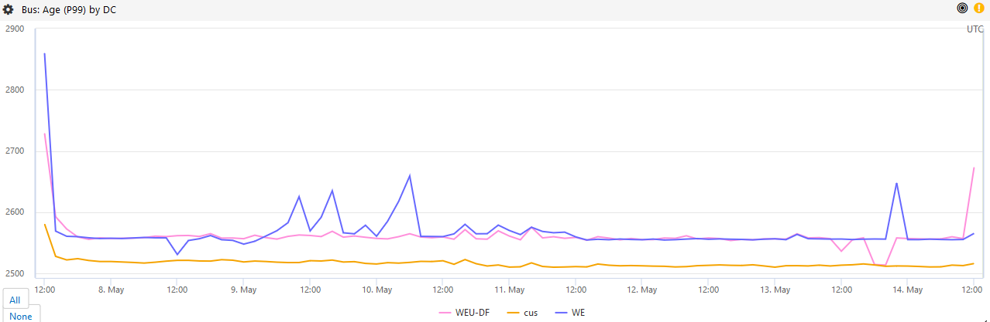
Livesite: Metering
Event age

Slide 47


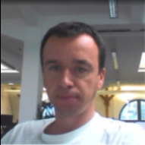








Team
Petr Rybak
Jakub Chocholowicz
Juraj Barat
Tomas Foltynek
Roman Soyka
Frantisek Kaduk
Juraj Blazek
Tibor Djurica Potpara
Stefan Uhrin
Jozef Palocko
Branislav Burjaniv

Slide 48
Summary
Books
Adrian Marriot: Life beyond Distributed Transactions: an Apostate’s Opinion
Martin Klepmann: Designing Data-Intensive Applications

Slide 49
Summary
Blogs
https://fknet.wordpress.com/
https://azure.microsoft.com/en-us/blog/how-skype-modernized-its-backend-infrastructure-using-azure-cosmos-db-part-1/
Source code
https://github.com/kadukf/blog.msdn.git
https://github.com/Azure/azure-documentdb-changefeedprocessor-dotnet
Async processing library: soon

